Slide 1

Chapter 9
XML files

Slide 2
Content
What is XML?
Syntax XML
Areas of application
Navigate through an XML file
Add, delete and modify elements of an XML File
Create an XML file

Slide 3
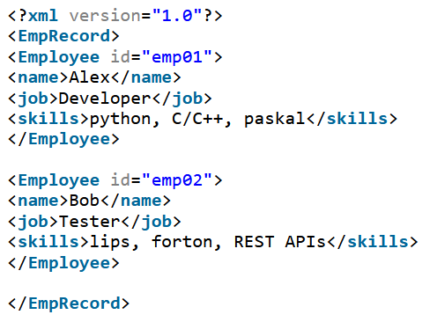
What is XML?
eXtensible Markup Language
is a W3C recommendation (since 1998)
meta-markup language, a kind of "super-HTML"
you can create your own tags
describes the semantics and the structure, not the formatting
is NOT a programming language
is a hierarchical data serialization method
designed to store and transport data
XML itself doesn’t do anything

Slide 4
Application areas
Creation of electronic documents
Exchange data between:
companies (B2B) (E-commerce)
integrate applications within one company (A2A)
different platforms
Thousands of XML formats exist, in many different industries, to describe day-to-day data transactions:
Stocks and Shares
Financial transactions
Medical data
Mathematical data
Scientific measurements
News information
Weather services

Slide 5
Application areas
Example in Java: using an xml document as a configuration file for your own (web) application
<?xml version="1.0" encoding="UTF-8"?> <project xmlns="http://maven.apache.org/POM/4.0.0" xmlns:xsi="http://www.w3.org/2001/XMLSchema-instance" xsi:schemaLocation="http://maven.apache.org/POM/4.0.0 https://maven.apache.org/xsd/maven-4.0.0.xsd"> <modelVersion>4.0.0</modelVersion> <parent> <groupId>org.springframework.boot</groupId> <artifactId>spring-boot-starter-parent</artifactId> <version>2.2.6.RELEASE</version> <relativePath/> </parent> <groupId>fact.it</groupId> <artifactId>project-olympics</artifactId> <version>0.0.1-SNAPSHOT</version> <name>project-olympics</name> <description>Keuzeproject 2</description> <properties> <java.version>11</java.version> </properties> <dependencies> <dependency> <groupId>org.springframework.boot</groupId> <artifactId>spring-boot-starter-jdbc</artifactId> </dependency> ….

Slide 6
Example
A shop with second-hand CDs is regularly asked to take over collections, but processing these questions is difficult:
Some providers send lists per artist, others per calendar year
Some providers send Excel files, other providers send web pages
Some providers forget to mention the name of the album
…

Slide 7
Example
Suppose the shop owner wants software to quickly and automatically compare the offered supply with the present stock.
For that purpsose XML can be a solution and make work easier.
<?xml version='1.0' encoding='utf-8'?> <offer> <cd> <album>Divide</album> <artist>Ed Sheeran</artist> </cd> <cd> <album>Kaleidoscope</album> <artist>Coldplay</artist> </cd> </offer>

Slide 8
XML file structure
<?xml version='1.0' encoding='utf-8'?> <offer> <cd> <album>Divide</album> <artist>Ed Sheeran</artist> </cd> <cd> <album>Kaleidoscope</album> <artist>Coldplay</artist> </cd> </offer>
The first line is optional. It contains the XML declaration with the XML version and the unicode used:
<?xml version='1.0' ?>
<?xml version='1.0' encoding='utf-8’?>
On the second line you find the name of the 'root' element => <offer>

Slide 9
XML file structure
<?xml version='1.0' encoding='utf-8'?> <offer> <cd> <album>Divide</album> <artist>Ed Sheeran</artist> </cd> <cd> <album>Kaleidoscope</album> <artist>Coldplay</artist> </cd> </offer>
The root has 2 child-elements called cd.
Each CD element in turn has 2 child-elements: album and artist.
Each XML element must have a closing tag.

Slide 10
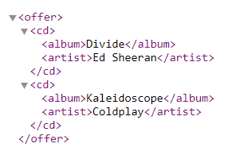
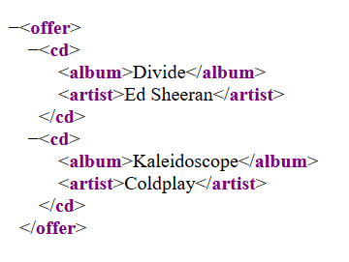
XML file in different browsers
XML file opened in Chrome
XML file opened in Firefox

Slide 11
Syntax XML
XML documents must have 1 root element
<root>
<child>
<subchild>…… </subchild>
</child>
</root>
Element names are case sensitive
<album>this is wrong</Album>
<album>this is correct</album>
Elements must have a closing tag
<artist>This is content</artist>
<artist/> when the tag is empty

Slide 12
Syntax XML
Elements must be nested correctly
<sentence><part>this is wrong</part>in XML</sentence>
<sentence><part>this is correct in XML</part></sentence>
Elements may have attributes. Their value must be between (double) quotes
<message date=“1 October”>
<from>Python teacher</from>
<to>1 ITF A</to>
</message>
Names start with a letter, followed by a letter, number, ".", "_", "-" or ":" (reserved sign). Names may not contain any blanks and cannot start with the letters XML.

Slide 13
Syntax XML
Comment as follows:
<!--comment-->
5 special characters have an 'entity reference’.
If you need the character | You write in the XML file
< | &lt;
> | &gt;
' | &apos;
" | &quot;
& | &amp;

Slide 14
XML in Python
In Python we will learn to
navigate through the structure of an XML document
add, delete and modify elements
create an XML file
All elements can be accessed through the XML DOM (Document Object Model) .
The XML DOM defines a standard way for accessing and manipulating XML documents. It presents an XML document as a tree-structure.

Slide 15
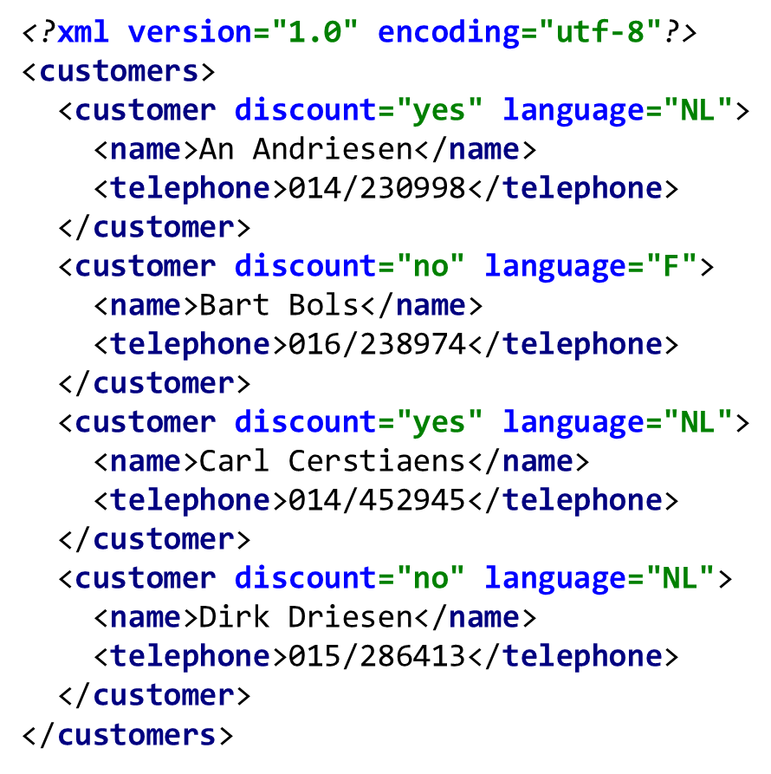
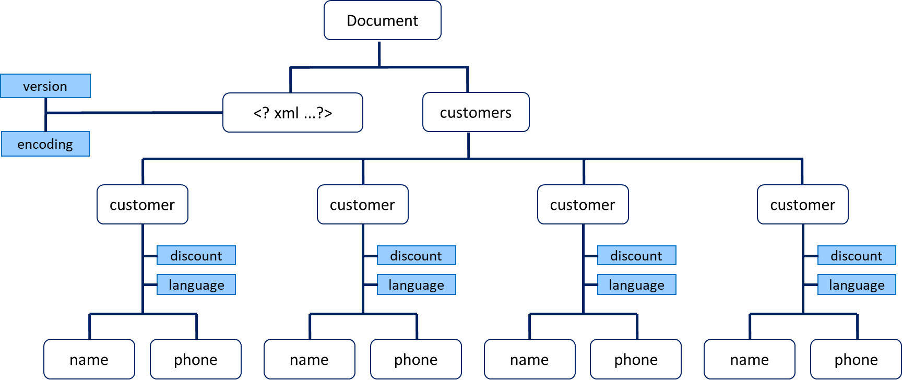
Example 1: tree structure customers.xml
node
attribute
Level 0
Level 1
Level 2
https://www.xmlviewer.org/ website to visualize the XML-structure

Slide 16
Example 1: Loading an XML file and building a tree structure
import xml.etree.ElementTree as ET
We import xml.etree.ElementTree: this module implements a simple but efficient API to parse and create XML data.
This module is usually abbreviated to ET
ET has two classes:
ElementTree: represents the entire XML document as a tree
Element: represents 1 node from the tree
Document
xmlDoc
<? xml ...?>
customers
root
ChildNodes from root
customer
customer
customer
customer
Notes:
A parser (from English to parse, dissect, and the Latin pars, part) is a computer program, or component of a program, that dissects the grammatical structure of an input according to a fixed grammar (parset). A parser converts the entered text into a data structure. Compare it to filling in a form with data in the given place in a given text format, such as block text.
The result of an operation with a parser is usually a tree structure: called the syntax tree.

Slide 17
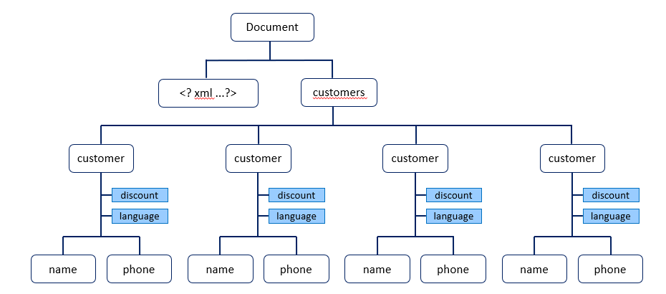

Example 1: Loading an XML file and building a tree structure
xmlDoc = ET.parse("customers.xml") root = xmlDoc.getroot()
We read the data from a file and the parse function builds the tree structure.
With getroot() we can access the root of the tree and give it an explicit name
print(root.tag, root.attrib)
The root has a tag and possibly also attributes
Output:

Slide 18
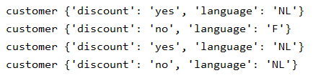
Example 1: navigating through the tree structure
for child in root: print(child.tag, child.attrib)
The root has a number of child nodes. The children of the root (or any other node) form a List, so we can go through it with a for loop
Output:
<?xml version="1.0" encoding="utf-8"?> <customers> <customer discount="yes" language="NL"> <name>An Andriesen</name> <telephone>014/230998</telephone> </customer> <customer discount="no" language="F"> <name>Bart Bols</name> <telephone>016/238974</telephone> </customer> <customer discount="yes" language="NL"> <name>Carl Cerstiaens</name> <telephone>014/452945</telephone> </customer> <customer discount="no" language="NL"> <name>Dirk Driesen</name> <telephone>015/286413</telephone> </customer> </customers>

Slide 19
Example 1: navigating through the tree structure
Child nodes are nested and can be reached with the node index or sequence number
Node index numbering starts at 0
<?xml version="1.0" encoding="utf-8"?> <customers> <customer discount="yes" language="NL"> <name>An Andriesen</name> <telephone>014/230998</telephone> </customer> <customer discount="no" language="F"> <name>Bart Bols</name> <telephone>016/238974</telephone> </customer> <customer discount="yes" language="NL"> <name>Carl Cerstiaens</name> <telephone>014/452945</telephone> </customer> <customer discount="no" language="NL"> <name>Dirk Driesen</name> <telephone>015/286413</telephone> </customer> </customers>
Output:
customer
{'discount': 'yes', 'language': 'NL’}
name
An Andriesen
telephone
014/230998
name
Dirk Driesen
telephone
015/286413
0
1
2
3
print(root[0].tag) print(root[0].attrib)
print(root[0][0].tag) print(root[0][0].text)
print(root[0][1].tag) print(root[0][1].text)
print(root[3][0].tag) print(root[3][0].text)
print(root[3][1].tag) print(root[3][1].text)
0
1
0
1
0
1
0
1

Slide 20
Example 1: navigating through the tree structure
Element has some useful methods:
iter | iterates recursively over all the sub trees below it (its children, their children, and so on).
findall | finds only elements with a tag which are direct children of the current element
find | finds the first child with a particular tag
text | accesses the element’s text content
get | accesses the element’s attributes

Slide 21
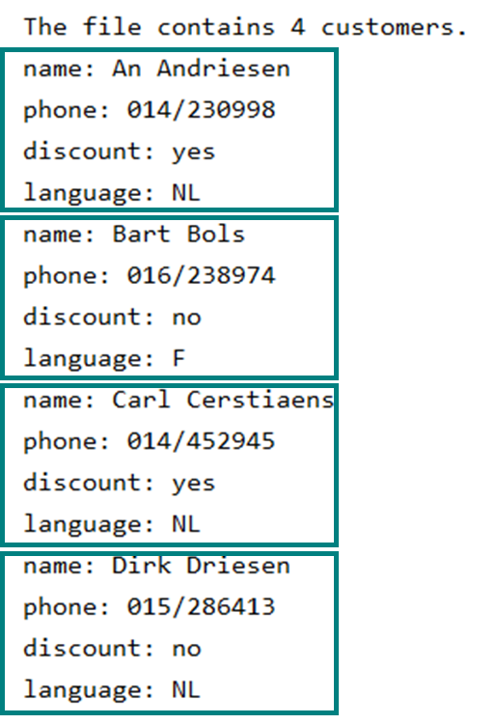
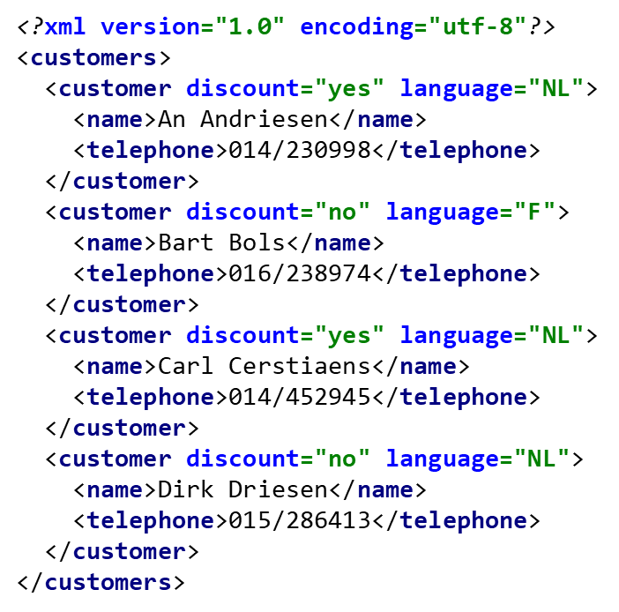
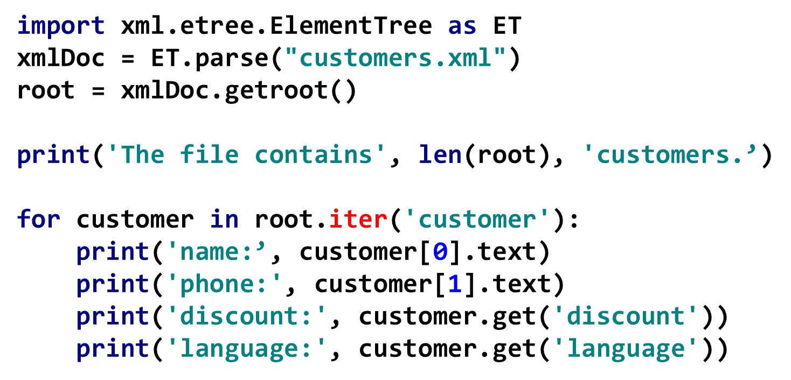
Example 1: navigating through the tree structure
We use the iter method which allows us to iterate over all the subtrees (the children, the children of the children...) of the root, looking for the nodes customer

Slide 22
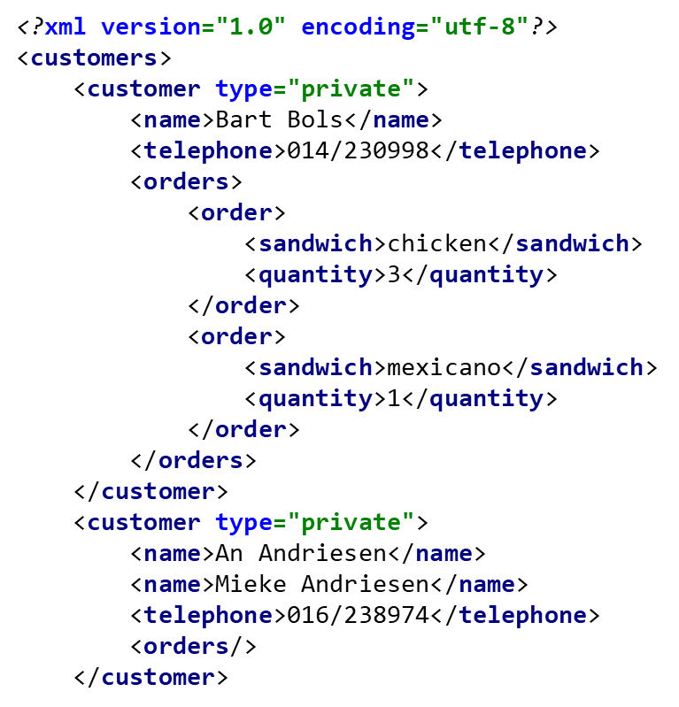
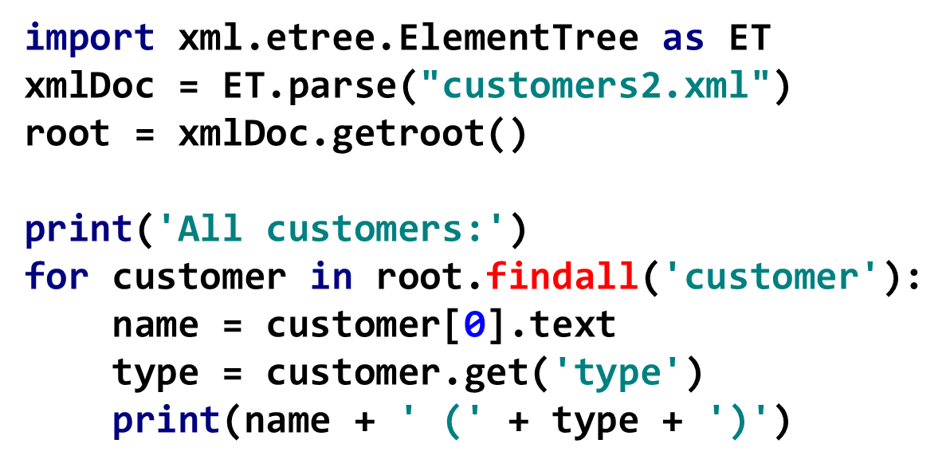
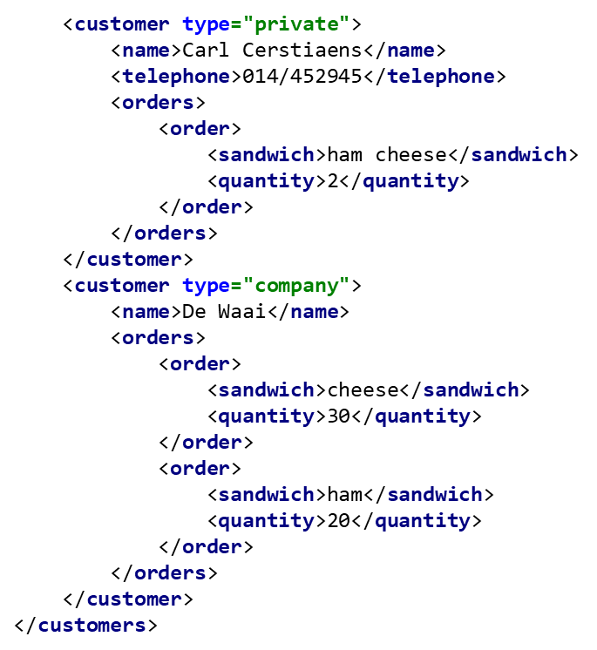
Example 2: customers2.xml
All customers:
Bart Bols (private)
An Andriesen (private)
Carl Cerstiaens (private)
De Waai (company)
We use the findall method which allows us to find every customer child of the root

Slide 23
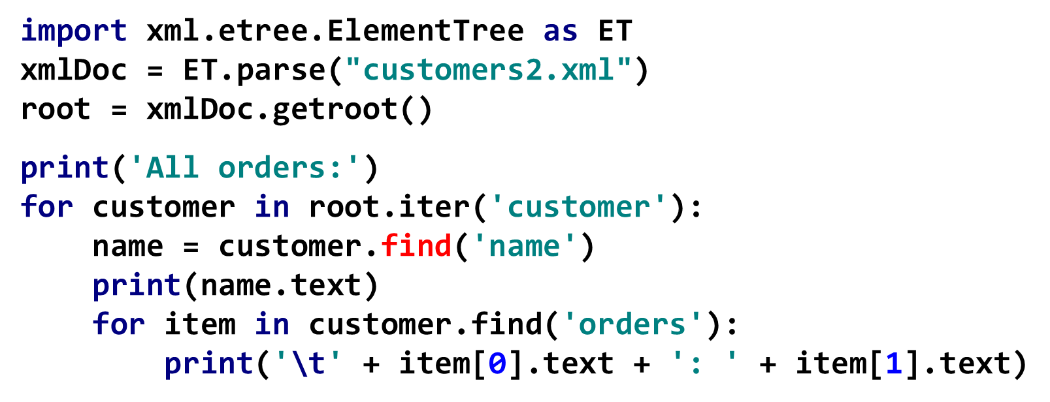
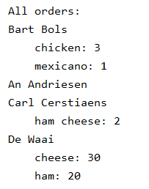

Example 2: customers2.xml
With the find method we can locate the first name child of each customer
We then try to find the first orders child of each customer. This node has a number of child nodes so we need a for loop to walk through.

Slide 24
Modify XML file
<?xml version="1.0" encoding="utf-8"?> <measurements> <measurement executor="JP"> <number>15</number> <month>September</month> <location>Block B</location> </measurement> <measurement executor="JP"> <number>33</number> <month>September</month> <location>Block P</location> </measurement> <measurement executor="AM"> <number>5</number> <month>October</month> <location>Block A</location> </measurement> <measurement executor="RZ"> <number>69</number> <month>November</month> <location>Block G</location> </measurement> <measurement executor="JP"> <number>50</number> <month>December</month> <location>Block A</location> </measurement> </measurements>
In Python we can
remove one or more nodes
change one or more nodes
make a new node
create a completely new XML file
save the XML file
We use the file measurements.xml

Slide 25
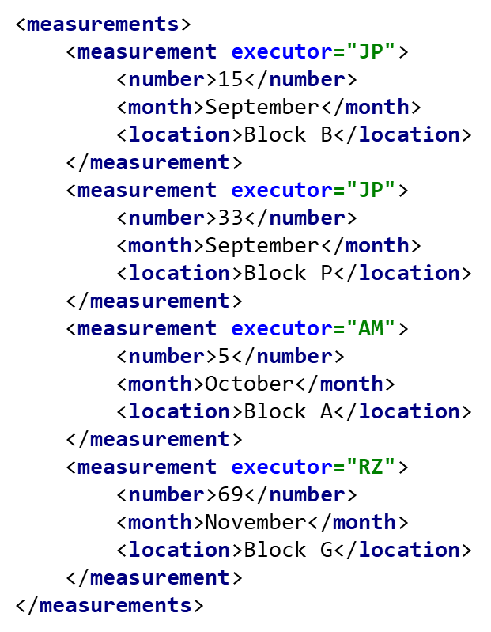
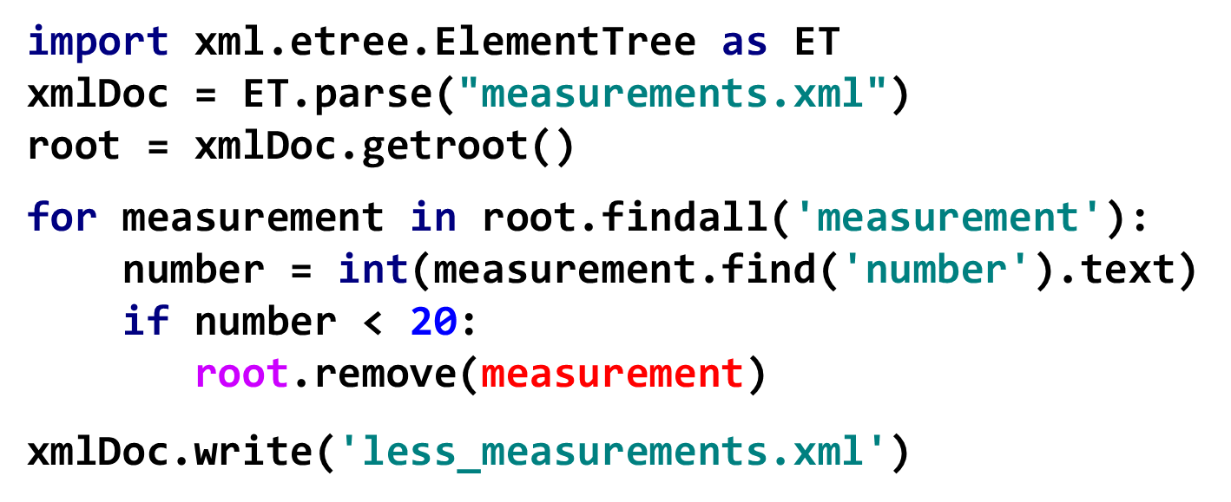
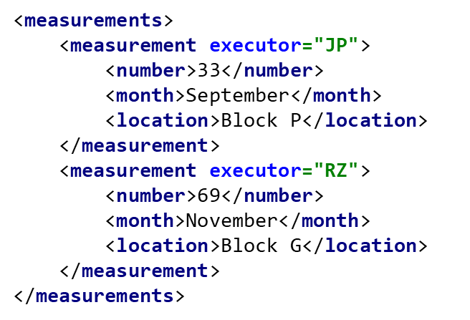
Example 3: removing a node
We want to remove all measurements for which the number < 20
with remove() you can remove the node (indicated in parentheses) which is a child from the node indicated in front of the dot
write() writes the XML document to a file

Slide 26
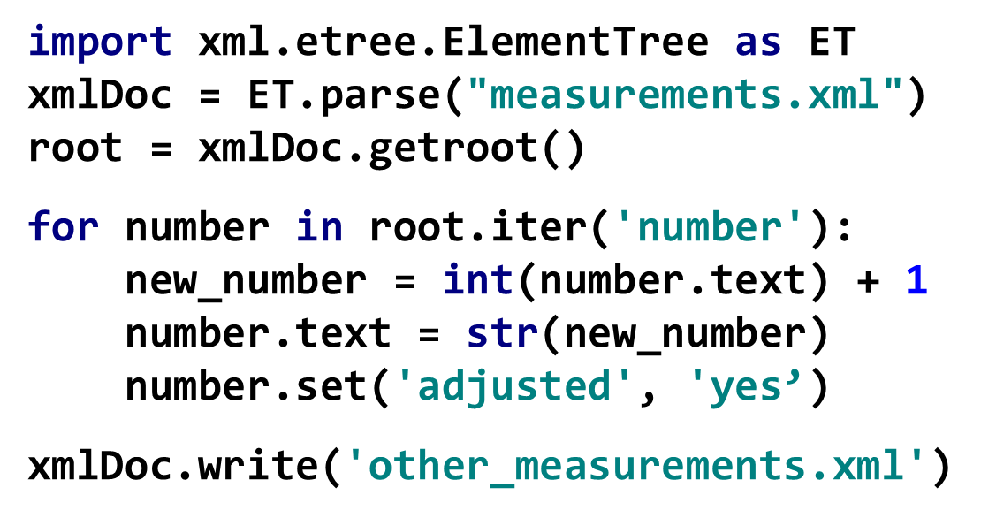
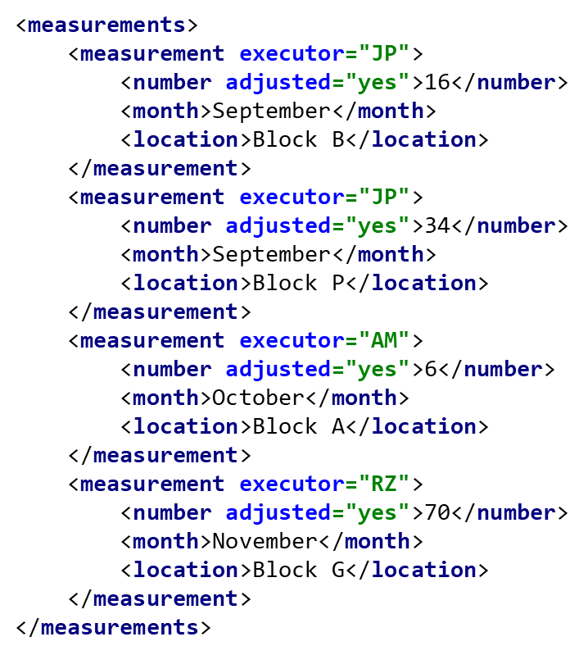
Example 4: adjusting a node
We want to increase the number by 1 and also add an attribute
text adjusts the content of the node
with set( ) you create a new attribute for the node

Slide 27
Example 5: adding a new node
We want to add a new measurement
<measurements> <measurement executor="JP"> <number>15</number> <month>September</month> <location>Block B</location> </measurement> . . . <measurement executor="RZ"> <number>69</number> <month>November</month> <location>Block G</location> </measurement> <measurement executor="CF"> <number>77</number> <month>December</month> <location>Block F</location> </measurement> </measurements>
import xml.etree.ElementTree as ET xmlDoc = ET.parse("measurements.xml") root = xmlDoc.getroot() measurement = ET.Element('measurement') measurement.set('executor', 'CF') number = ET.SubElement(measurement, 'number') number.text = str(77) month = ET.SubElement(measurement, 'month') month.text = 'December' location = ET.SubElement(measurement, 'location') location.text = 'Block F' root.append(measurement) xmlDoc.write('more_measurements.xml')

Slide 28
Example 6: create a completely new XML file
Result in PyCharm (use Ctrl-Alt-L for this layout):
import xml.etree.ElementTree as ET root = ET.Element('countries') # append two nodes to the root finland = ET.Element('country') root.append(finland) finland.text = 'Finland' sweden = ET.Element('country') sweden.text = 'Sweden' root.append(sweden) # append third element with different working method ireland = ET.SubElement(root, 'country') ireland.text = 'Ireland' tree = ET.ElementTree(root) tree.write('countries.xml', encoding='utf-8', xml_declaration='True')
<?xml version='1.0' encoding='utf-8'?> <countries> <country>Finland</country> <country>Sweden</country> <country>Ireland</country> </countries>
ElementTree presents the entire XML document as a tree

